Slide 1


Profit and Loss Statement
The profit and loss statement is a key financial document that summarizes a company's revenues, costs, and expenses over a specific period of time. It provides a clear picture of a business's profitability and financial performance.
by Vadlamudi Arun kumar
AV

Slide 2

Net Sales
Definition
Importance
Calculation
Net sales represent the total amount of revenue a company generates from its core business activities, minus any discounts, returns, or allowances.
Net sales is a critical metric that helps businesses track their top-line growth and overall market performance.
Net Sales = Gross Sales - Discounts, Returns, and Allowances

Slide 3

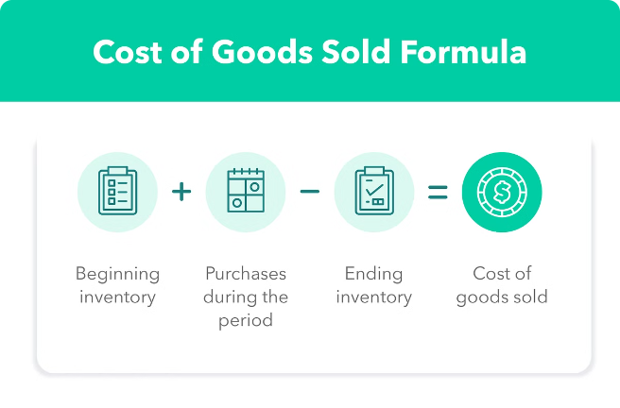
Cost of Goods Sold (COGS)
Definition
COGS represents the direct costs associated with producing the goods or services a company sells.
Includes
Raw materials, labor, and manufacturing overhead costs.
Importance
COGS is a crucial metric for understanding a company's profitability and gross margin.
Calculation
COGS = Manufacturing Cost+ Freight Cost +Other Cost

Slide 4


Gross Margin
1
Definition
Gross margin is the difference between net sales and the cost of goods sold.
2
Importance
Gross margin is a key indicator of a company's profitability and efficiency.
3
Calculation
Gross Margin = Net Sales - Cost of Goods Sold

Slide 5

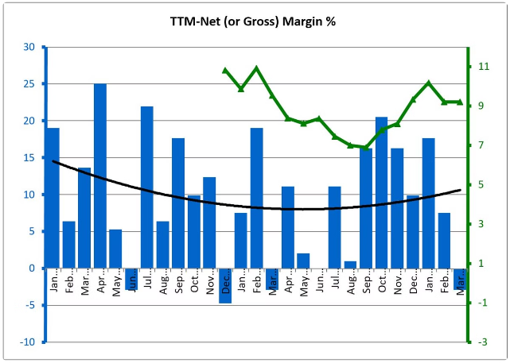
Gross Margin Percentage
1
Definition
Gross margin percentage is the ratio of gross margin to net sales, expressed as a percentage.
2
Importance
It provides insight into a company's pricing power and operational efficiency.
3
Calculation
Gross Margin Percentage = (Gross Margin / Net Sales) x 100

Slide 6

Operational Expenses
Definition
Includes
Importance
Operational expenses, or OpEx, are the ongoing costs associated with running a business, excluding the cost of goods sold.
Rent, utilities, salaries, marketing, and administrative expenses.
OpEx analysis helps management identify areas for cost reduction and improve overall profitability.

Slide 7





Net Profit
Definition
Net profit is the amount of revenue remaining after all expenses, costs, and taxes have been accounted for.
Calculation
Net Profit = Gross Margin - Operational Expenses - Taxes
Significance
Net profit is the ultimate measure of a company's financial performance and profitability.

Slide 8






Visualizing the Data
Customer performance
Visualize the top-line revenue by Customer.
Market vs Target Performance
Analyze Market and It’s Target.
P & L Statement by Monthly
Profit and Loss Statement by Fiscal Year and Monthly Wise.
P & L Statement By Market
Profit and Loss Statement Market Wise.

